Slide 1

Unsupervised Learning
Koh June wen | 2112956

Slide 2
Contents
1)
2)
3)
Feature Engineering
Model Building and Evaluation
Segmentation Results

Slide 3

Feature Engineering

Slide 4
Nature of Dataset
7 Numeric Features
5 Categoric Features

Slide 5
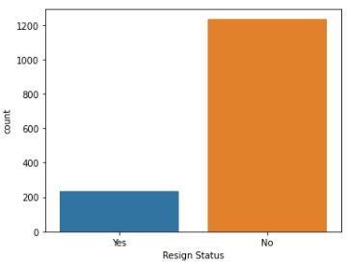
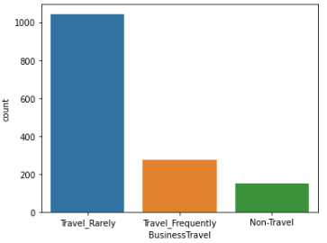
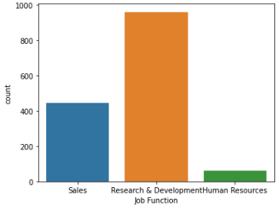
Nature of Dataset
Dataset is very imbalanced
E.g. Human Resources in Job Function only has 63 staff and Resign Status only has 237 staff
Problem: There will be one prominent, largely and unequally scattered class, that to some extent shadows other, less prominent, and as well unequally scattered classes – which further have very different distances between clusters. This could lead to not-so-prominent clusters to not be found at all.

Slide 6
Feature Engineering
Due to the imbalanced dataset, I have considered the under-sampling method.
Cons: Discarding many instances may lead to loss of informative majority class instances and degrade clustering performance. Also the dataset is very small, 1470 records. If I were to perform under-sampling, too much data will be lost
As the objective of the segmentation is to identify the group of staff who have resigned there is no need to identify other less significant clusters. Therefore, I decided to keep the imbalanced dataset.

Slide 7
Feature Engineering
I performed ordinal encoding for BusinessTravel feature
Non-Travel > 0
Travel-Rarely > 1
Travel-Frequently > 3
I have added a weight to the Travel-Frequently category because Non-Travel means that the staff has zero travel, Travel-Rarely means that there is an upper limit to the number of business travels the staff has been on, while Travel-Frequently does not have an upper limit.

Slide 8
Feature Engineering
Problem with categoric variables:
The sample space for categorical data is discrete, and doesn’t have a natural origin. A Euclidean distance function on such a space is not really meaningful. As someone put it, “The fact that a snake possesses neither wheels nor legs allows us to say nothing about the relative value of wheels and legs.”

Slide 9
Feature Engineering
Gower Dissimilarity
Gower Distance is a distance measure that can be used to calculate distance between two entities whose attributes has a mix categorical and numerical values.
The distance is always a float between 0 (identical) and 1 (maximally dissimilar)

Slide 10

Feature Engineering
Gower Dissimilarity Formula
Numeric Variables: $s_{ijk}=1−\frac{|x_{ik}−x_{jk}|}{R_{k}}$
This is a L1 distance between the two values normalized by a quantity $R_{k}$. The quantity $R_{k}$ refers to the range of feature (population / sample)
Categoric Variables: $s_{ijk}={1x}_{ik}=x_{jk}$
This score will be 1 if the categories are the same and 0 if they are not
Converting to distance: $d_{Gower}=\sqrt{1−S_{Gower}}$

Slide 11
Feature Engineering
Gower Dissimilarity is non-Euclidean and non-metric.
Therefore, methods based on Euclidean distance must not be used e.g. K-means, Ward, etc

Slide 12

Model Building and Evaluation

Slide 13


Models Tested
Agglomerative Clustering
Gaussian Mixtures

Slide 14
Models Tested
Why Agglomerative Clustering?
Hierarchical Clustering Model, so it can use non-Euclidean distances
As each point initially starts as a cluster, the effects of an imbalanced dataset will be less pronounced.
Why Gaussian Mixtures?
Does not use a distance measure
Applies a probability distribution around cluster centers to work out the likelihood that a data point belongs to a given cluster.

Slide 15
Model Tuning
Agglomerative Clustering Hyperparameters:
n_clusters
linkage
Gaussian Mixtures Hyperparameters:
n_components
covariance_type

Slide 16
Model Tuning
Evaluation Metrics
Calinski Harabasz Score
The ratio of the variance of a datapoint compared to points in other clusters, against the variance compared to points within its cluster.
A high score is desirable
Works similar to Silhouette Score, however, it will give a low score to segmentation that has identified outliers.

Slide 17
Model Tuning
Primary Evaluation Metrics
Calinski Harabasz Score
The ratio of the variance of a datapoint compared to points in other clusters, against the variance compared to points within its cluster.
A high score is desirable
Works similar to Silhouette Score, however, it will give a low score to segmentation that has identified outliers.
Secondary Evaluation Metrics
Silhouette Score

Slide 18
Cluster Analysis
Relative Importance (Categoric Variables)
Proportion of categories with values 1 in each cluster compared with the proportion of categories with values 1 in the entire dataset
The closer the value is to 0 the more similar the proportion is to the population, which means that the feature could probably be segmented by random selection
Snake Plot (Numeric Variables)
Shows the general cluster distribution in comparison to the population.
Closer the value for the variable is to 0 the less significant the feature is for the cluster
Relative Importance (Numeric Variables)
Calculated by Cluster Average / Population Average – 1
Values will be within the range of -1 to 1
The closer the value is to 0 the less important the variable is to the cluster.

Slide 19
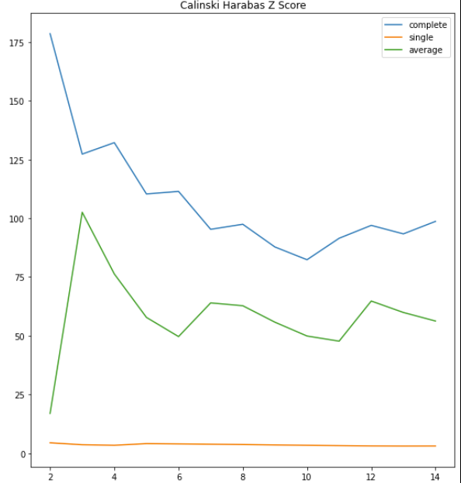
Agglomerative Clustering
n_clusters = 2 | linkage = complete

Slide 20
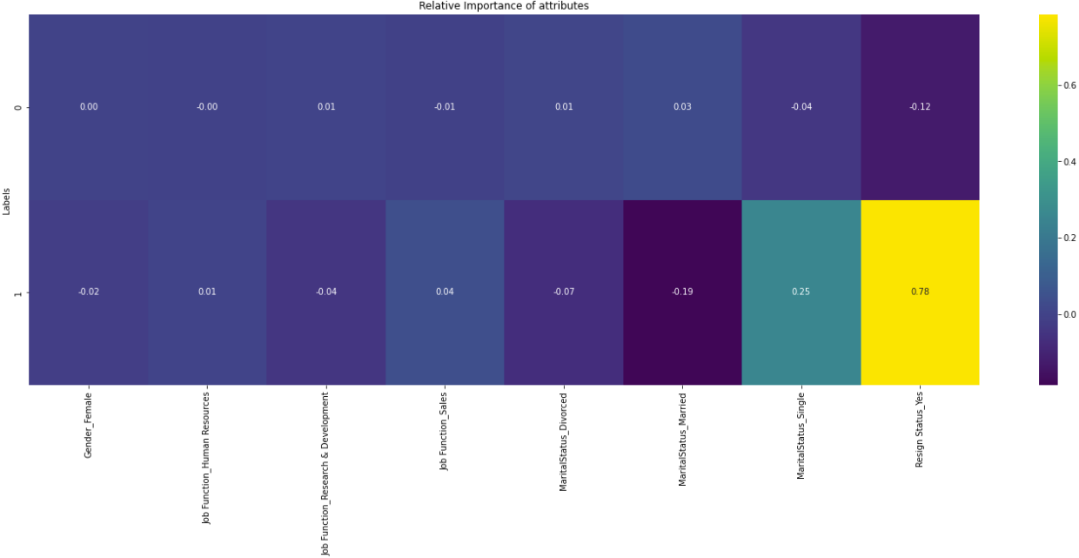
Agglomerative Clustering
n_clusters = 2 | linkage = complete
Resign Status_Yes for Cluster 1 has a very high relative importance, followed by MartialStatus_Single. The rest of the features have little to no relative importance
All of the features for Cluster 0 has no relative importance.

Slide 21
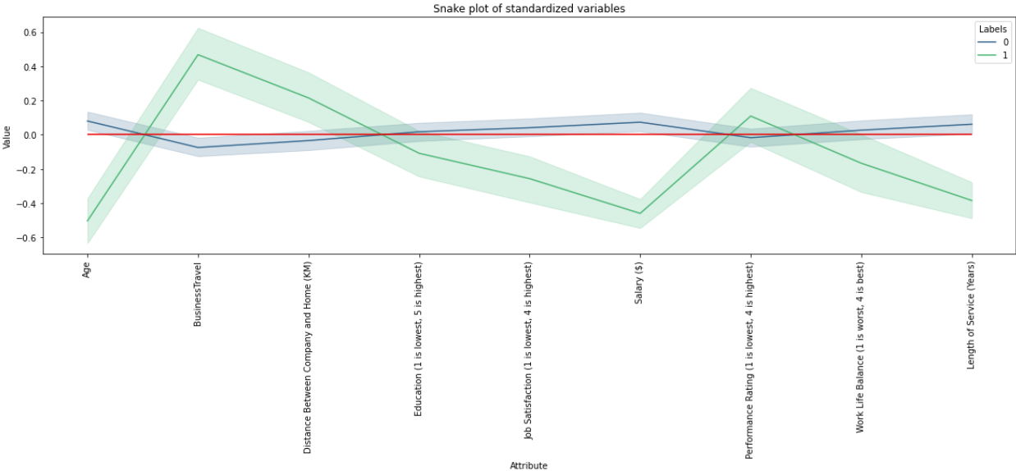
Agglomerative Clustering
n_clusters = 2 | linkage = complete
Age, BusinessTravel, Salary, Length of Service for Cluster 1 has the highest deviation from 0.
Cluster 0 stays very close to the 0 line.

Slide 22
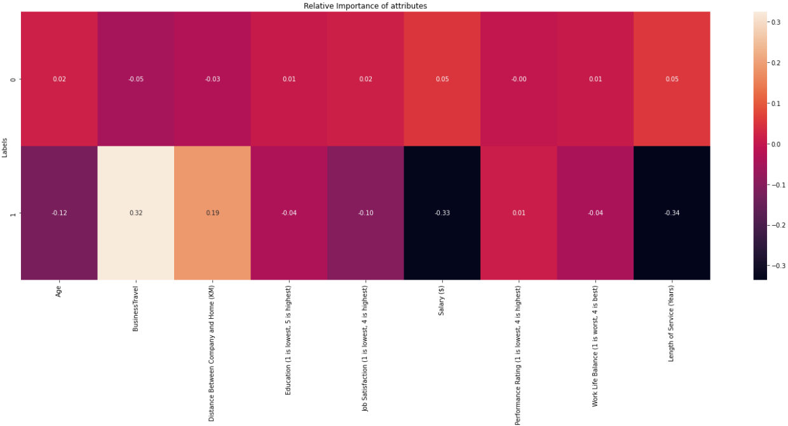
Agglomerative Clustering
n_clusters = 2 | linkage = complete
BusinessTravel, Salary, Length of Service for Cluster 1 has the highest relative importance
Cluster 0 does not have any feature with any relative importance.

Slide 23
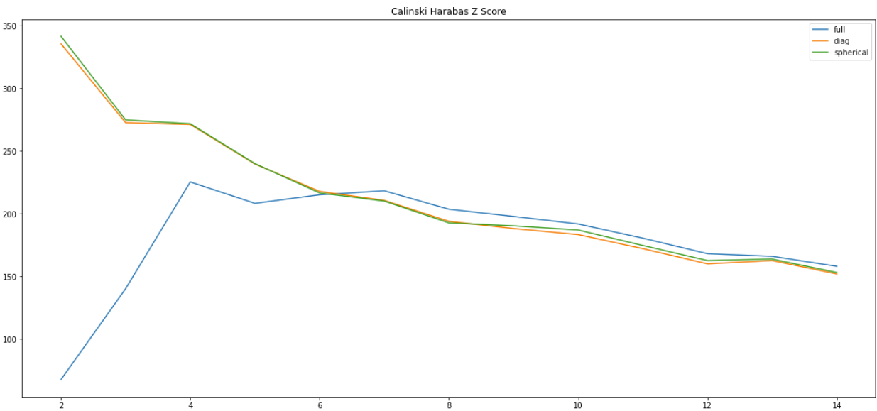
Gaussian Mixture
1.
n_components = 2 |covariance_type = spherical
n_components = 4 | covariance_type = full
2.

Slide 24
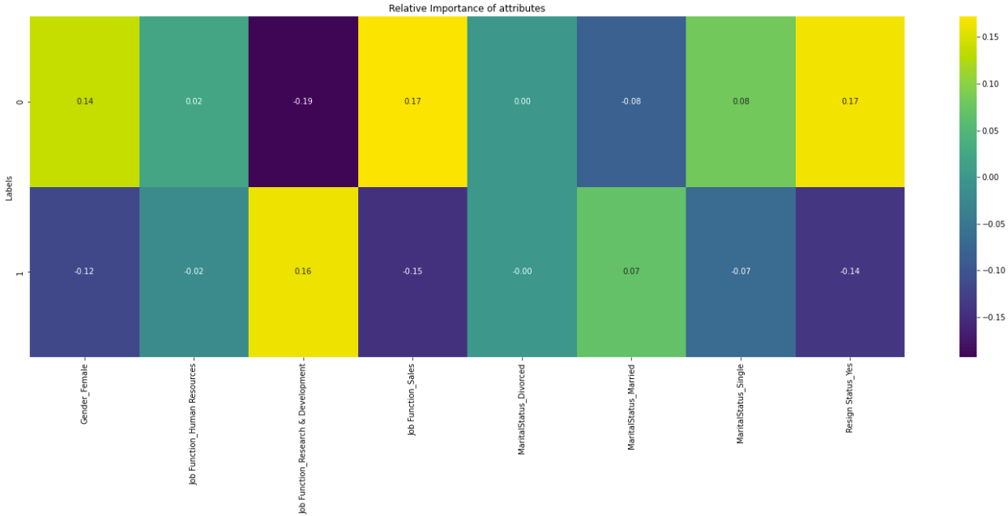
Gaussian Mixture
n_components = 2 | covariance_type = spherical
None of the features for either clusters have a high relative importance value.

Slide 25
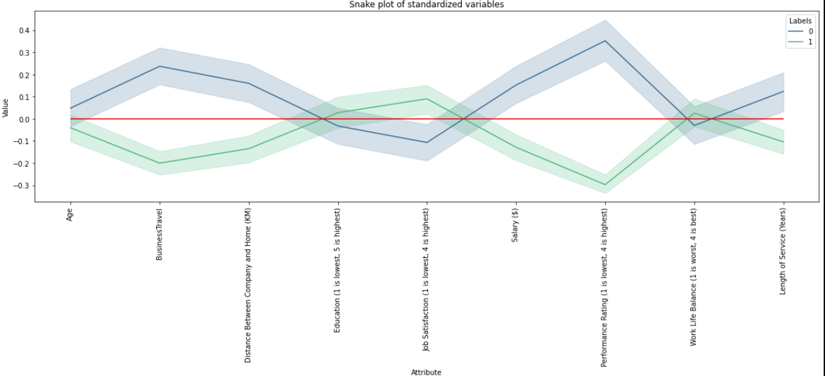
Gaussian Mixture
n_components = 2 | covariance_type = spherical
BusinessTravel, Performance Rating has the highest deviation from 0 for both clusters

Slide 26
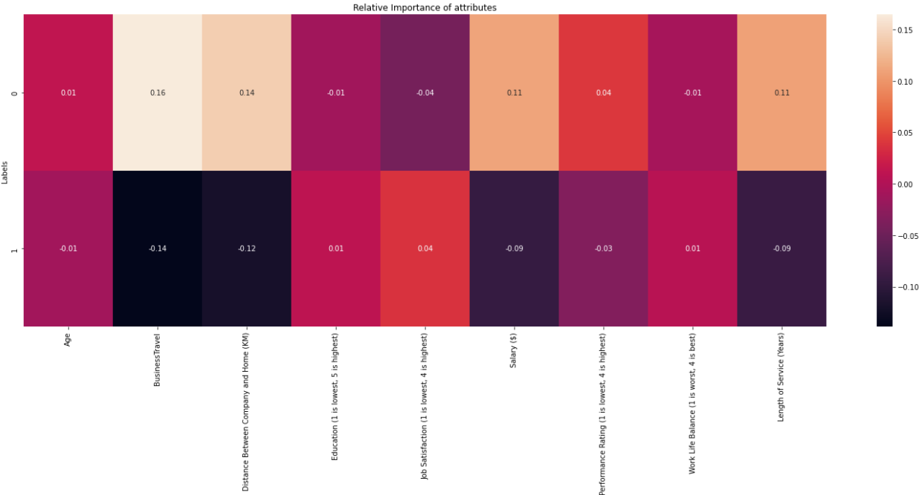
Gaussian Mixture
n_components = 2 | covariance_type = spherical
None of the features have a high relative importance for both clusters.

Slide 27
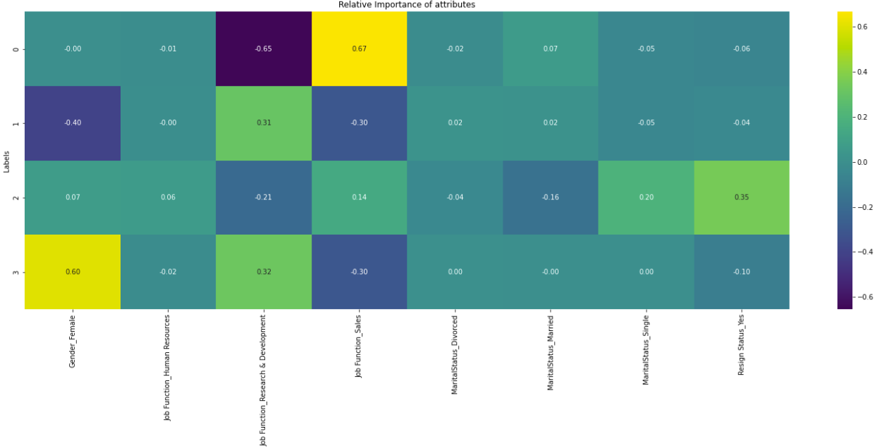
Gaussian Mixture
n_components = 4 | covariance_type = full
Gender, R&D, Sales have a high relative importance for Cluster 1,3
R&D, Sales have a high relative importance for Cluster 0
Resign Status has a high relative importance for Cluster 2

Slide 28
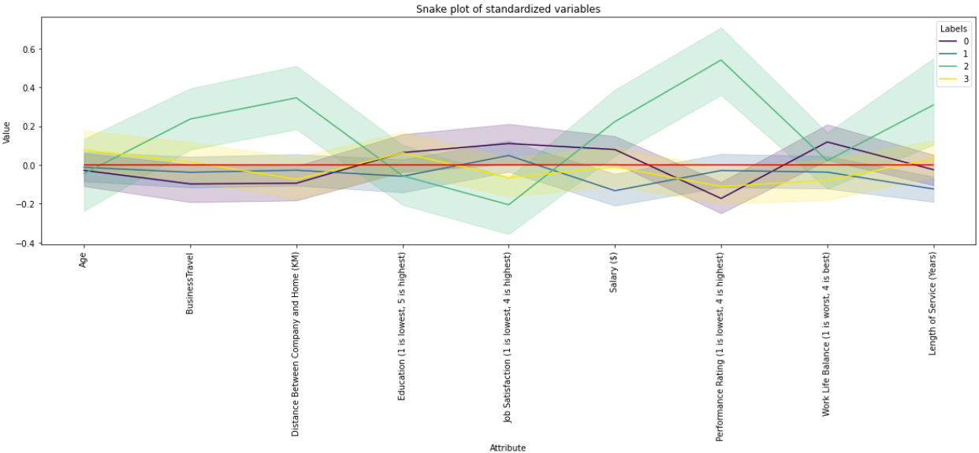
Gaussian Mixture
n_components = 4 | covariance_type = full
BusinessTravel, Distance Between Company and Home, Performance Rating and Length of Service have high deviation from 0 for Cluster 2
The other clusters are very close to the population distribution.

Slide 29
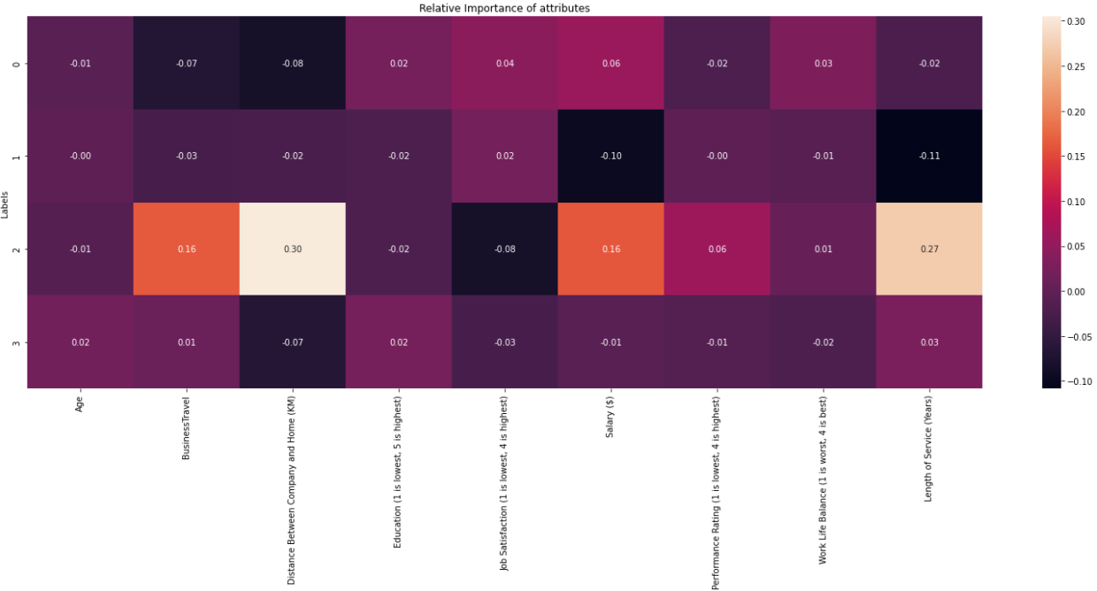
Gaussian Mixture
n_components = 4 | covariance_type = full
Distance Between Company and Home, Length of Service have high relative importance for Cluster 2
The other clusters have very low relative importance for all features

Slide 30

Segmentation Results

Slide 31
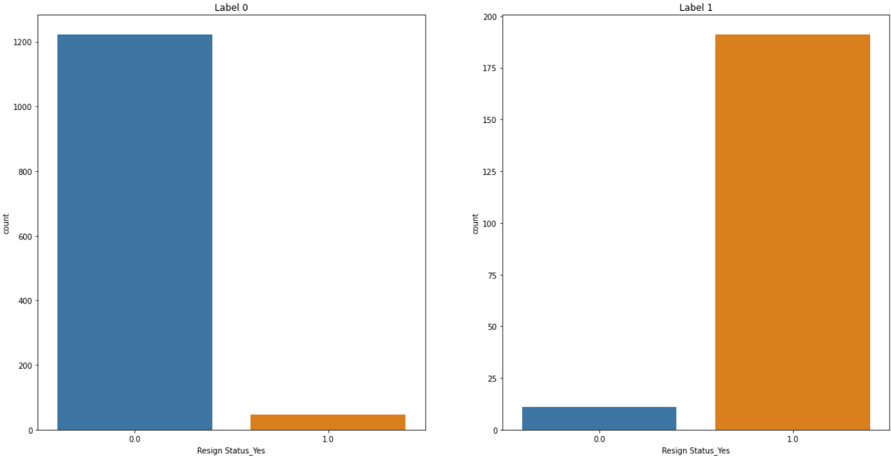
Best Model
Agglomerative Clustering (n_clusters = 2 | linkage = complete)
The segmentation on Resign Status is the most distinct out of the models tested.
Has captured 80% of the staff that has resigned

Slide 32
Segmentation Analysis
Cluster 0
Characteristics are identical to the entire population of staff, because the size of the dataset is 1268 out of 1470, which is 86.3% of the dataset.
Cluster 1
Characteristics of staff who have resigned

Slide 33
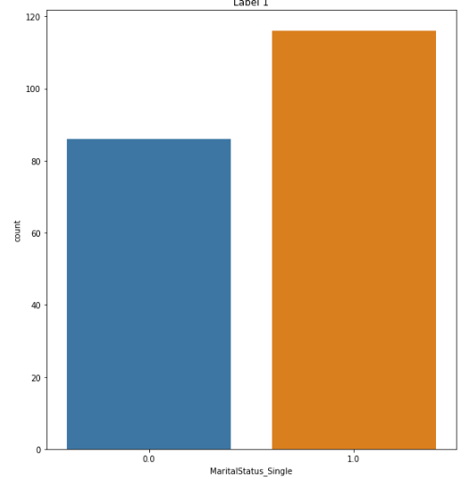
Segmentation Analysis
Cluster 1 – MaritalStatus_Single
A large proportion of the staff who resigned are Single
About 57.4% of staff

Slide 34
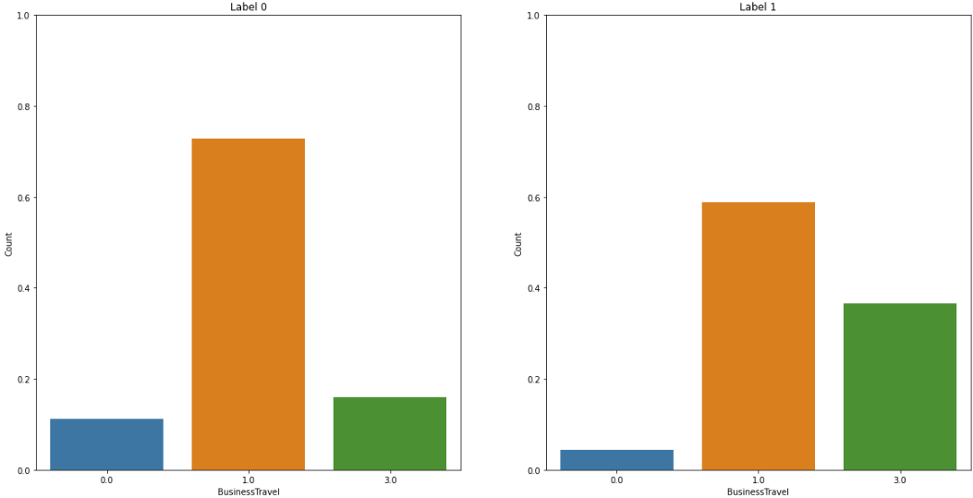
Segmentation Analysis
Cluster 1 - BusinessTravel
In comparison to Cluster 0, those staff that have travelled, especially those that have travelled frequently, have resigned.

Slide 35
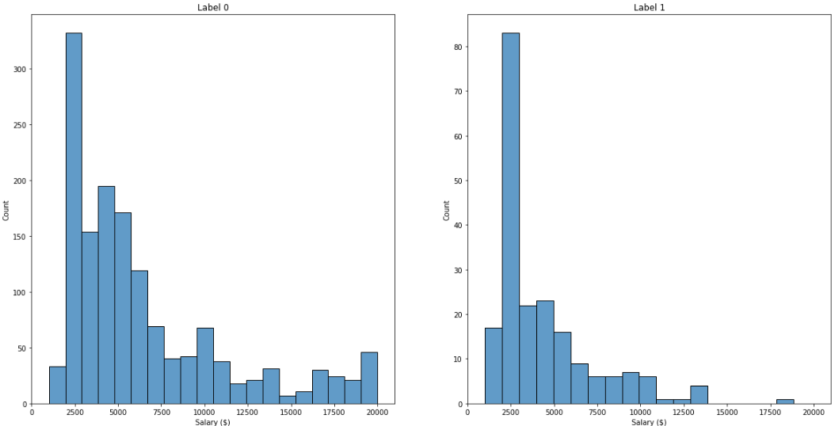
Segmentation Analysis
Cluster 1 - Salary
In comparison to Cluster 0, the staff that have resigned are generally those that have a lower salary with the most at $2500.
The range of salary for the resignees is between $0 and $12500

Slide 36
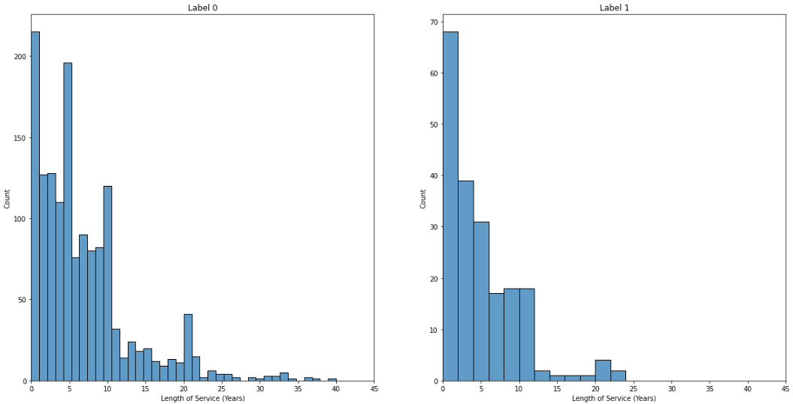
Segmentation Analysis
Cluster 1 – Length of Service
In comparison to Cluster 0, where it peaks at 0, 5, 10 years, Cluster 1 only peaks at 0 years for those who have resigned.
This shows that the longer the staff has been in service the likelihood of them resigning gets lower.

Slide 37

Conclusion

Slide 38
Conclusion
The group of people that the management should so something to retain them are people who are:
Single
Experience a lot of business travels
Have a low salary
Have a short length of service

